Slide 1
SALES DASHBOARD
This explains the sales dashboard of a store.
From the analysis and insights built, the Visualization came up with the Sales by region Sales by subcategory of the products Sales by Customer segments and category Sales by states Yearly Trend in sales Sales by Customer segment Quantity Demanded Sales by Category It was observed from the valuable visualizations that the West region recalled the higher sales of the products. On the subcategory sales by region, it was observed that in the central region, chairs got the higher sales. On the East region, Phones accessories recalled the highest sales while machines got the highest sales in the South region. In the West region, chairs also recalled the highest sales. Technology was indicated to possessed the highest sales in the sales by customer segments while California recalled a high sale amongst the states. The highest sales was obtained in 2018 on the trend of sales and consumers was noted to give the organization highest sales. On the Quantity mostly ordered in the different categories, chairs got the highest sales. On Office suppliers, binders got a higher sale. Technology recall a higher sale in the category of products. Recommendations: The need for the organization to focus on the sales with low sales and know the possible reasons for the low sales of these products. States with higher should not be taking with levity, hence, the organization needs to know why there is higher sales through market research and channel the observations or results obtained to states with lower sales. This can also be observed as relate to products.
Analytic Tool: Tableau

Slide 2
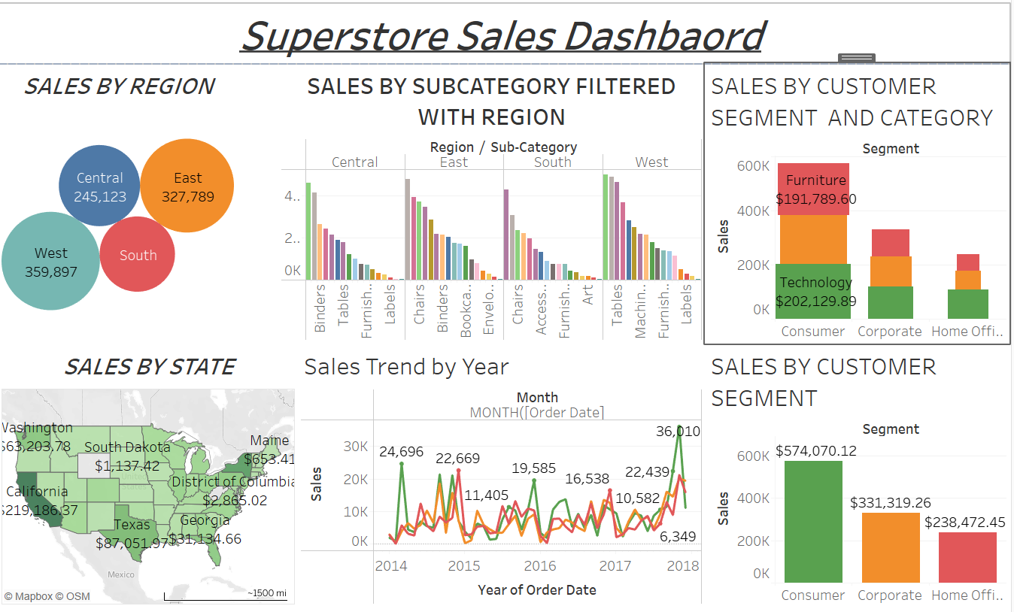

Slide 3
